Slide 1

Credit Card Customer Retention
Jonah Turner

Slide 2
Dataset
Collection
Features:
Utilization Rate
Gender
Transaction Count
Education
Income
Time inactive
Others

Slide 3
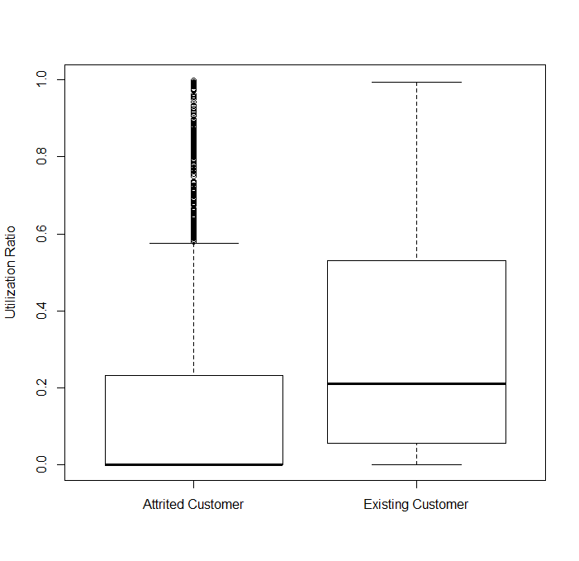
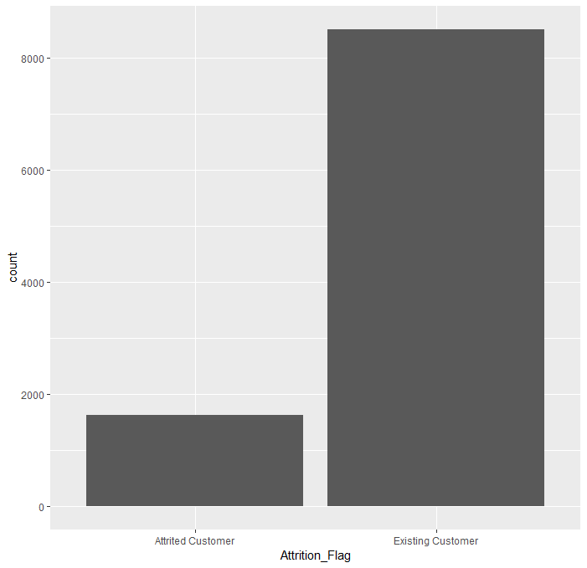
EDA

Slide 4
Questions
What are the most common features of attrited customers?
What are the characteristics of strong credit card customers?
Which features show the greatest variance between attrited and existing customers?

Slide 5
Attrited Customer Features

Slide 6
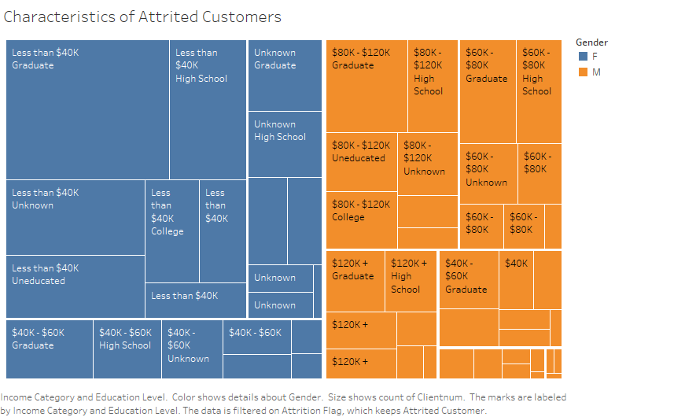

Slide 7
Strong Customer Characteristics

Slide 8
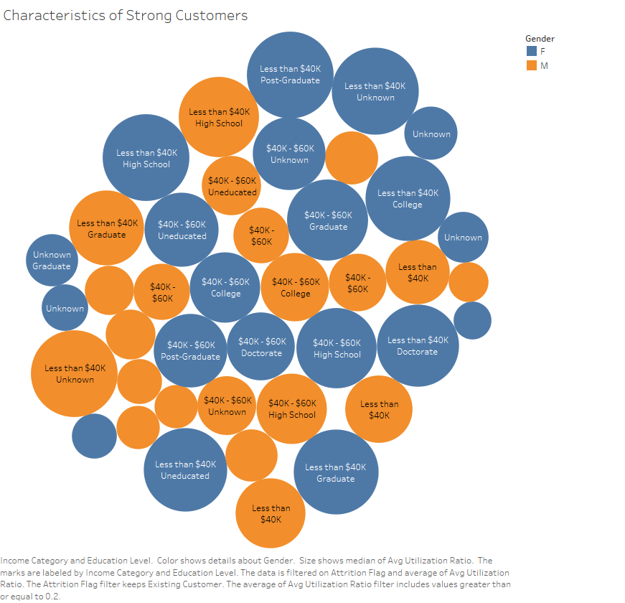

Slide 9
Differences Between Customers

Slide 10
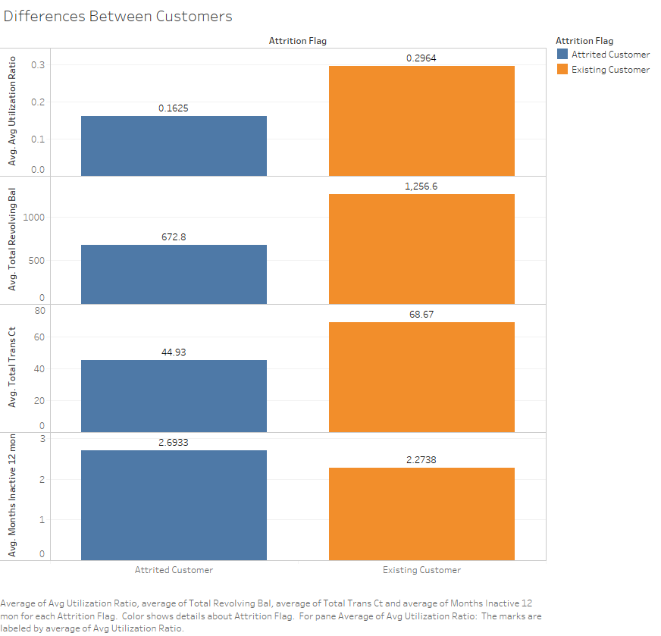

Slide 11
Results
Attrited customers
Gender, income bracket
Strong customers
Income
Differences
Utilization rates, revolving balance, total transaction count, activity

